Slide 1


Slide 1
Java Data Base Connectivity
A Unit of iBirds Group
STAR INFOTECH COLLEGE
Affiliated to MDS University
INVESTOR OPPORTUNITY

Slide 2
Slide 3
Recap of Session 8 ?
Usage of JTable.
Edit operation with JTable.
Database Concepts.

Slide 3
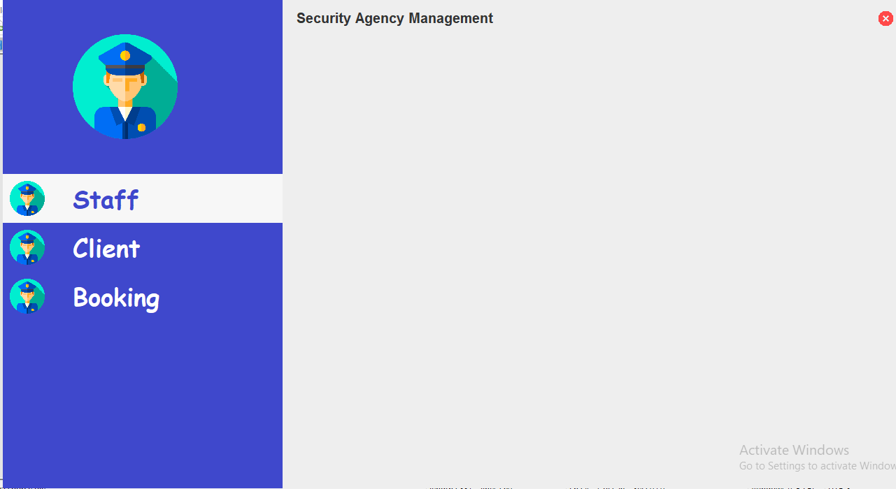
Slide 3
What we will be learn today
Making AWT Panel Layout for crud operation.

Slide 4

Slide 3

Slide 5
Slide 3
Do some hands-on exercise
Make Panel which look a like today class example.
Make Panel Layout for ‘classes’ Table records insertion.
Fields of ‘classes’ table
Id
class_name
fees
capacity

Slide 6
Slide 15
THANK YOU!
CONTACT US AT:
admin@ibirdscollege.com
8890488666, 7073125888, 6375154474

Slide 7

Slide 3
ANY QUESTIONS ?

